Slide 1

Testing scientific code Because you’re worth it
Pietro Berkes and Lisa Schwetlick

Slide 2

Testing patterns

Slide 3
What a good test looks like
What does a good test look like? What should I test?
Good:
Short and quick to execute
Easy to read
Exercise one thing
Bad:
Relies on data files
Messes with “real-life” files, servers, databases

Slide 4
Basic structure of test
A good test is divided in three parts:
Given: Put your system in the right state for testing
Create data, initialize parameters, define constants…
When: Execute the feature that you are testing
Typically one or two lines of code
Then: Compare outcomes with the expected ones
Define the expected result of the test
Set of assertions that check that the new state of your system matches your expectations

Slide 5
Test simple but general cases
Start with simple, general case
Take a realistic scenario for your code, try to reduce it to a simple example
Example: Tests for ‘lower’ method of strings
def test_lower(): # Given string = 'HeLlO wOrld' expected = 'hello world' # When output = string.lower() # Then assert output == expected

Slide 6
Test special cases and boundary conditions
Code often breaks in corner cases: empty lists, None, NaN, 0.0, lists with repeated elements, non-existing file, …
This often involves making design decision: respond to corner case with special behavior, or raise meaningful exception?
def test_lower_empty_string(): # Given string = '' expected = '' # When output = string.lower() # Then assert output == expected
Other good corner cases for string.lower():
‘do-nothing case’: string = 'hi'
symbols: string = '123 (!'
Notes:
First of all, you should start with testing your code with
explain typical test structure
show general case: two words, upper case chars randomly dispersed
special cases
SHOW THIS (cut & paste code)

Slide 7
Common testing pattern
Often these cases are collected in a single test:
def test_lower(): # Given # Each test case is a tuple of (input, expected_result) test_cases = [('HeLlO wOrld', 'hello world'), ('hi', 'hi'), ('123 ([?', '123 ([?'), ('', '')] for string, expected in test_cases: # When output = string.lower() # Then assert output == expected

Slide 8
Parametrize
Sometimes you want to run the same test multiple times with different values
Option 1: for loop in your test
Option 2: parametrize
@pytest.mark.parametrize("a", [1,2,3,4])
def test_addition_increases(a):
assert 5+a>a

Slide 9
Parametrize
… is also useful when you want to test different cases and their outcomes!
import pytest
@pytest.mark.parametrize("string, expected",
[('HeLlO wOrld', 'hello world’),
('hi', 'hi’),
('','')])
def test_lower(string, expected):
# When output = string.lower()
# Then assert output == expected

Slide 10
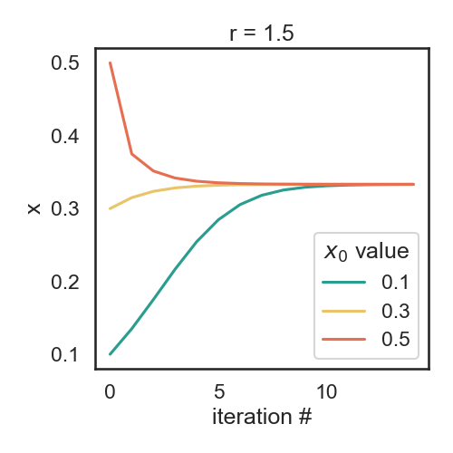

Excursion: Logistic Map
Sometimes used as a simple model for population growth

Slide 11
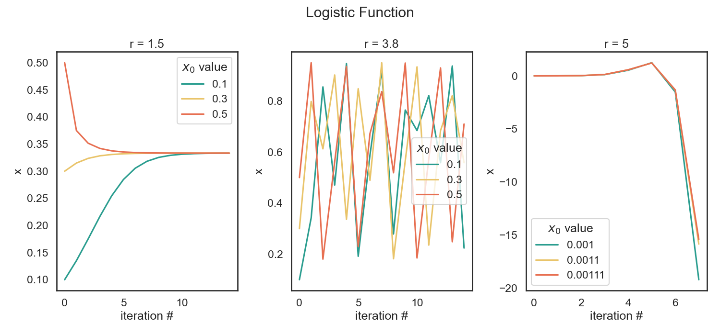
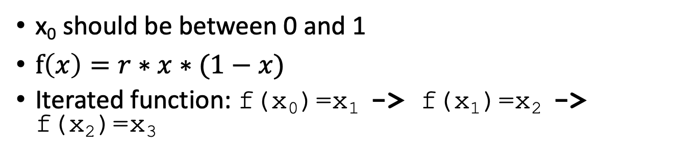
Excursion: Logistic Map
x₀ should be between 0 and 1
$f\left(x\right)=r∗x∗(1−x)$
Iterated function: f(x₀)=x₁ -> f(x₁)=x₂ -> f(x₂)=x₃
Notes:
where x_{n} is a number between zero and one, that represents the ratio of existing population to the maximum possible population

Slide 12
Excursion: Logistic Map
Looking at these plots, what could you test?

Slide 13
Hands-on!
First fork the repo https://github.com/aspp-latam/2023-heraklion-testing-project on GitHub and clone your own copy!
READ THE INSTRUCTIONS IN THE README.md!
Here’s a summary:
a) Implement the logistic map f(𝑥)=𝑟∗𝑥∗(1−𝑥) . Use @pytest.mark.parametrize to test the function for the following cases:
x=0.1, r=2.2 => f(x, r)=0.198
x=0.2, r=3.4 => f(x, r)=0.544
x=0.75, r=1.7 => f(x, r)=0.31875
b) Implement the function iterate_f that runs f for it iterations, each time passing the result back into f. Use @pytest.mark.parametrize to test the function for the following cases:
x=0.1, r=2.2, it=1 => iterate_f(it, x, r)=[0.198]
x=0.2, r=3.4, it=4 => iterate_f(it, x, r)=[0.544, 0.843418, 0.449019, 0.841163]
x=0.75, r=1.7, it=2 => iterate_f(it, x, r)=[0.31875, 0.369152]
c) Import and use the plot_trajectory function from the plot_logfun module to look at the trajectories generated by your code. Try with values r<3, r>4, and 3<r<4 to get an intuition for how the function behaves differently with different parameters.

Slide 14
Marking tests (xfail)
Aside from parametrize, there are some other built in markers
Sometimes you have a test that fails, but for good reason or you just want to deal with it later…
Expected failure (xfail)
Outputs an “x” (or “X”) in place of the “.”
@pytest.mark.xfail
def test_something():
...

Slide 15
Marking tests (skip)
It is also possible to skip tests
Useful when the feature doesn’t exist yet or the test is very slow
@pytest.mark.skip(reason=“functionality not yet implemented”)
def test_something():
...

Slide 16
Marking tests with custom markers
If you have lots of tests, you can categorize them with your own markers
although for custom mark names you need to register the marks “pytest.ini”
https://docs.pytest.org/en/7.1.x/example/markers.html#registering-markers
Example:
Smoke tests check for really basic failure: run these frequently
Other tests may be many or too slow to run every time and test for more edge cases
@pytest.mark.smoke
def test_something_basic():
...
> pytest –m smoke
> pytest –m ”smoke and not slow”

Slide 17
Strategies for testing scientific code

Slide 18
Strategies for testing learning algorithms
Learning algorithms can get stuck in local maxima, the solution for general cases might not be known (e.g., unsupervised learning)
Turn your validation cases into tests
Stability tests:
Start from final solution; verify that the algorithm stays there
Start from solution and add a small amount of noise to the parameters; verify that the algorithm converges back to the solution
Parameter Recovery: Generate synthetic data from the model with known parameters, then test that the code can learn the parameters back
Notes:
…
There is no general rule for testing these algorithm, for each specific algorithm there are usually validation cases (e.g, a classifier might be validated using two classes of very different objects)

Slide 19
Learning algorithms fit the parameters of a model to observed data
y = ax + b + noise
a = -1.2
b = 3

Slide 20
Generate synthetic data from the model to test the learning algorithm by recovering the parameters
1) Fix initial parameters
a* = 0.5
b* = -1.3

Slide 21
Generate synthetic data from the model to test the learning algorithm by recovering the parameters
1) Fix initial parameters
2) Generate synthetic data
y = a* x + b* + noise
a* = 0.5
b* = -1.3

Slide 22
Generate synthetic data from the model to test the learning algorithm by recovering the parameters
1) Fix initial parameters
2) Generate synthetic data
y = a* x + b* + noise
a* = 0.5
b* = -1.3
3) Run the algorithm
a = 0.5098
b = -1.287
y = ax + b + noise

Slide 23
Generate synthetic data from the model to test the learning algorithm by recovering the parameters
1) Fix initial parameters
2) Generate synthetic data
y = a* x + b* + noise
a* = 0.5
b* = -1.3
4) Compare
3) Run the algorithm
a = 0.5098
b = -1.287
y = ax + b + noise

Slide 24
Other common cases
Test general routines with specific ones
Example: test polynomial_expansion(data, degree) with quadratic_expansion(data)
Test optimized routines with brute-force approaches
Example: test function computing analytical derivative with numerical derivative

Slide 25

Randomness in Testing
Using randomness in testing can be useful
For confirming generalizability and stability
For finding corner cases or numerical problems
Using Random/Sampled input data to test whether the result is as expected
def test_something():
for _ in range(10): r = np.random.rand()
assert my_random_function(r)
Notes:
numpy.random.RandomState!
random_state = np.random.RandomState(SEED)
random_state.rand()
otherwise using the global seed, if any external library uses np.random it can screw up the determinism

Slide 26
Random Seeds and Reproducibility
When running tests that involve radomness and some test doesn’t pass it is vital to be able to reproduce that test exactly!
Computers produce pseudo-random numbers: setting a seed resets the basis for the random number generator
This is essential for reproducibility
At a minimum, you should manually set the seed for your random test
SEED = 42
random_state = np.random.RandomState(SEED)
random_state.rand()
Notes:
numpy.random.RandomState!
random_state = np.random.RandomState(SEED)
random_state.rand()
otherwise using the global seed, if any external library uses np.random it can screw up the determinism

Slide 27
Hands On!
READ THE INSTRUCTIONS IN THE README.md!
a) Write a randomized test that checks that, for r=1.5, any random starting points converge to the attractor f(x, r) = 1/3.

Slide 28
A Pytest Solution
This is not so prominent in the docs, because non-scientific coding uses random testing more rarely
In scientific coding, when you deal with randomness it is very relevant
What do we want?
For each (random) test there should be a seed
For each run of the test, the seed should be different
That seed should be printed with the test result
It needs to be possible to explicitely run the test again with that seed!

Slide 29
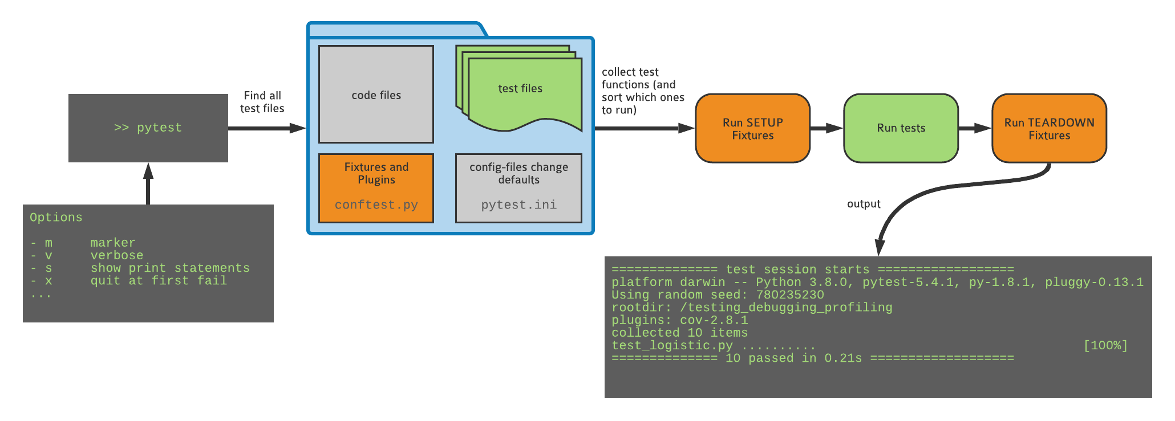
Pytest

Slide 30
Fixtures (minimal solution)
Fixtures are functions that are run before the tests are executed
import numpy as np
import pytest
# set the random seed for once here
SEED = np.random.randint(0, 2**31)
@pytest.fixture
def random_state():
print(f'Using seed {SEED}')
random_state = np.random.RandomState(SEED)
return random_state
def test_something(random_state): random_state.rand()
Notes:
If you want it to make a random seed for the whole module instead fo for every test, use “scope=‘module’”

Slide 31
Hands On!
READ THE INSTRUCTIONS IN THE README.md!
a) Write a randomized test that checks that, for r=1.5, any random starting points converge to the attractor f(x, r) = 1/3.
b) Add a fixture at the top of your test file, that lets you print the seed to the console.

Slide 32

Fixtures (real solution)
conftest.py is a magical file! (don’t import it!)
conftest.py can be used to define custom behavior or plugins. Fixtures can also be defined here, so that they can be used by all tests.
See the file conftest_example.py in the repo you forked. If you rename it the functions defined there select a seed for each test and allow you to pass a seed on the commandline using --seed 123

Slide 33
Hands On!
READ THE INSTRUCTIONS IN THE README.md!
a) Write a randomized test that checks that, for r=1.5, any random starting points converge to the attractor f(x, r) = 1/3.
b) Add a fixture at the top of your test file, that lets you print the seed to the console.
c) Add a conftest.py file to set a random seed before each run and make possible failures reproducible
d) Check that the console output of pytest now includes the seed!

Slide 34
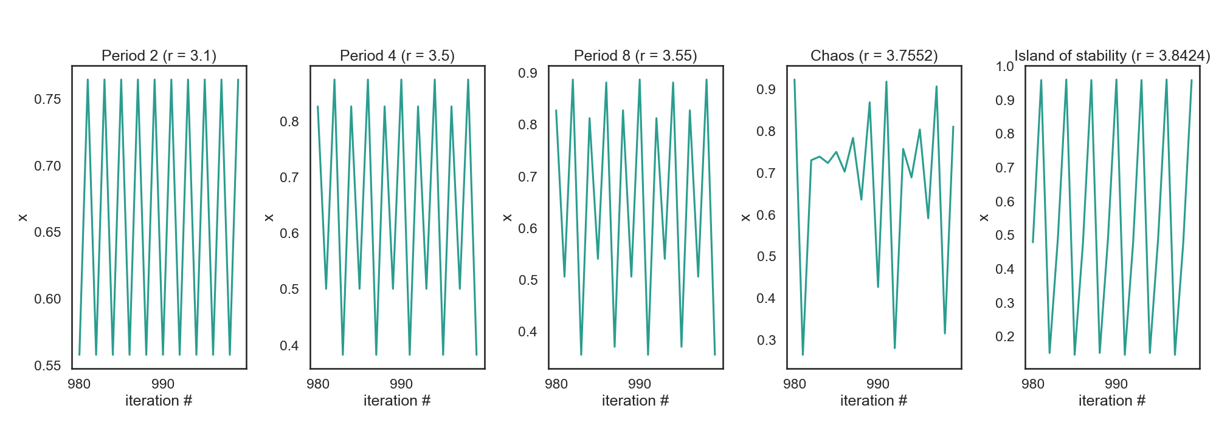
Excursion: Logistic Equation
Between r=3 and r=4 the logistic map has a range of behaviors
Periodic vs. chaotic

Slide 35
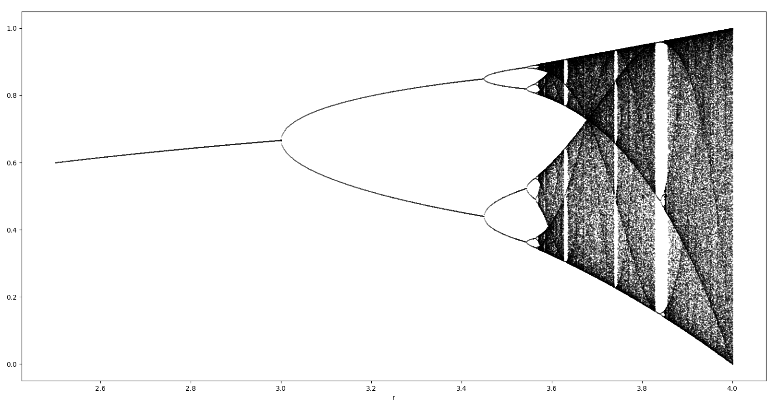
Excursion: Logistic Equation

Slide 36
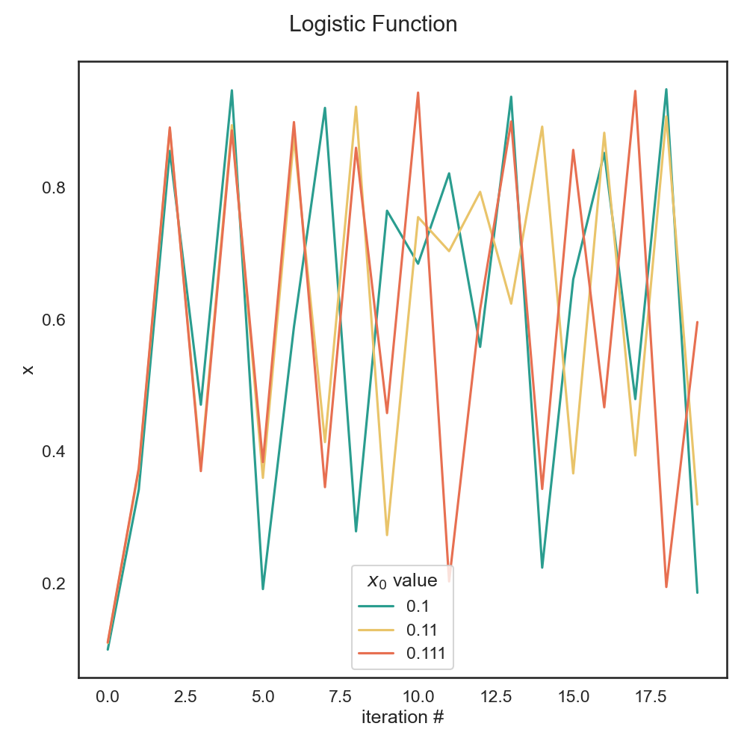

Excursion: Logistic Equation
Sensitive Dependence on Initial Conditions (SDIC)
Even seeds that are very close, quickly find completely different itineraries
Butterfly effect

Slide 37
Hands on!
Some r values for 3 < r < 4 have some interesting properties: a chaotic trajectory neither diverges nor converges.
a) Use the plot_bifurcation function from the plot_logfun module using your implementation of f and iterate_f to look at the bifurcation diagram. The function generates an output image, bifurcation_diagram.png
b) Write a test that checks for chaotic behavior when r=3.8. Run the logistic map for 100000 iterations and verify the conditions for chaotic behavior:
1) The function is deterministic: this does not need to be tested in this case
2) Orbits must be bounded: check that all values are between 0 and 1
3) Orbits must be aperiodic: check that the last 1000 values are all different
4) Sensitive dependence on initial conditions: this is the bonus exercise (in readme)
The test should check conditions 2) and 3)!

Slide 38

Testing is good for your self-esteem
Immediately: Always be confident that your results are correct, whether your approach works of not
In the future: save your future-self some trouble!
If you are left thinking “it’s cool but I cannot test my code because XYZ”, talk to us during the week and we’ll show you how to do it ;-)
You, in 2023
You, in 2024
Notes:
in Python2 environment:
py.test -v mdp/test/test_node_covariance.py
and
py.test mdp/test/
(it takes one minute)

Slide 39
Thank you!

Slide 41

Testing patterns

Slide 42



You, in 2023
You, in 2024
Notes:
in Python2 environment:
py.test -v mdp/test/test_node_covariance.py
and
py.test mdp/test/
(it takes one minute)

Slide 43
Example: eigenvector decomposition
Consider the function values, vectors = eigen(matrix)
Test with simple but general cases:
use full matrices for which you know the exact solution (from a table or computed by hand)
Test general routine with specific ones:
use the analytical solution for 2x2 matrices
Generate data from the model:
generate random eigenvalues, random eigenvector; construct the matrix; then check that the function returns the correct eigenvalues and -vectors
Test with boundary cases:
test with diagonal matrix: is the algorithm stable?
test with a singular matrix: is the algorithm robust? Does it raise appropriate error when it fails?

